Slide 1

Ocular Disease Recognition
GUIDE:
MR.V.GOKULAKRISHNAN.,M.E,(PhD) ASSISTANT PROFESSOR, COMPUTER SCIENCE & ENGINEERING
TEAM MEMBERS:
MADHUBALAN M (DSUG20104088) MANO A (DSUG20104093)
RAKESH J (DSUG20104124) RAMKUMAR R (DSUG20104125)

Slide 2
Domain Description:
The deep learning domain encompasses a subset of machine learning techniques inspired by the structure and function of the human brain’s neural networks. Deep learning models consist of multiple layers of interconnected nodes (neurons) that process and learn from data representations in a hierarchical manner.
These models excel at tasks such as image and speech recognition, natural language processing, and more, due to their ability to automatically extract intricate patterns and features from large datasets.

Slide 3
Abstract:
Ocular disorders have become more prevalent throughout time, with one of the causes being changes in human behaviour patterns brought on by technology and the creation of technological equipment.
The diagnosis of ocular pathology using fundus images is a significant
difficulty in health care.
The aim of our project is to develop a combination of feature extraction methods and Neural Networks to recognize common types of visual disorders using the fundus images.
Fundus photographs are ocular documentation that record the
appearance of a patient’s retina.

Slide 4
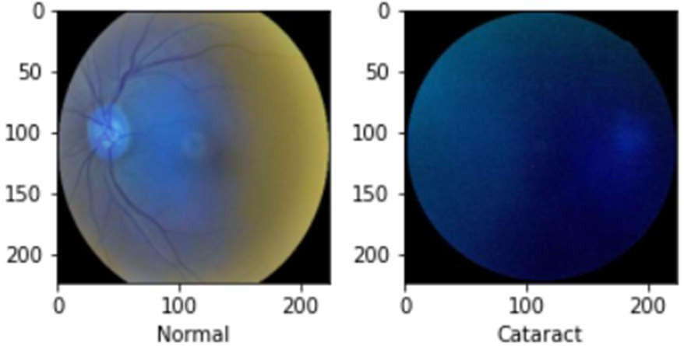
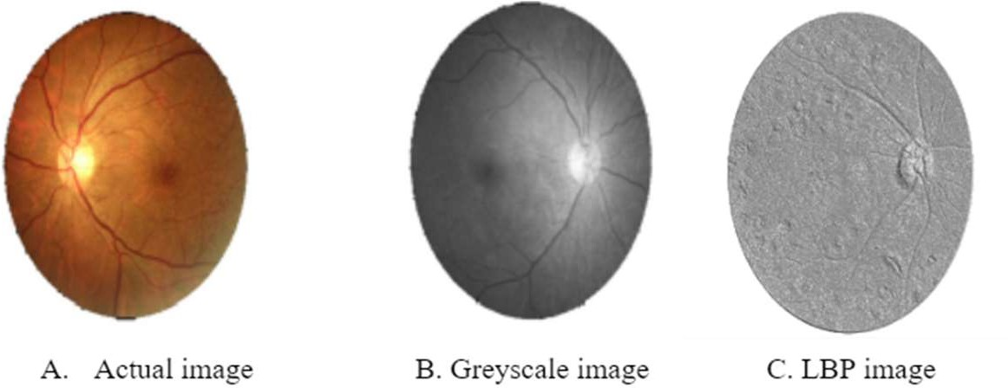
Dataset:
This dataset contains 7000 images with 5000 training images and 1000 testing images.
This dataset contains various types of eye images such as Diabetes, Glaucoma, Cataract, Related Macular Degeneration, Myopia, Hypertensive Retinopathy and other ones.
The features of the image are extracted through lbp feature extractor.

Slide 5
Models:
VGG19 : It is a convolutional neural network trained on a subset of the ImageNet dataset, a collection of over 14 million images belonging to 22,000 categories.It has 138 million parameters with a total of 19 layers including weights.
ResNet50 : It is a convolutional neural network that is 50 layers deep. A 7×7 kernel convolution alongside 64 other kernels with a 2-sized stride. A max pooling layer with a 2-sized stride. 9 more layers—3×3,64 kernel convolution, another with 1×1,64 kernels, and a third with 1×1,256 kernels.
Vision Transformer : It applies a Transformer-like design to selected areas of the picture. A sequence of vectors is created by dividing a picture into fixed- size patches, linearly embedding each one, adding position embeddings, and then feeding the assembled vectors to a conventional Transformer encoder.

Slide 6
LITERATURE SURVEY
S.NO | TITLE | ALGORITHM | MERITS | DEMERITS
1 | Deep Transfer Learning Strategy to Diagnose Eye Related Conditions and Diseases: An Approach Based on Low-Quality Fundus Images | Convolutional Neural Network (CNN) | Efficient use of resources | Overfitting & Limited adaptivity
2 | A Novel Meibomian Gland Morphology Analytic System Based on a Convolutional Neural Network | Convolutional Neural Network (CNN) | Automated analysis | Dependency on Training Data Quality

Slide 7
S.NO | TITLE | ALGORITHM | MERITS | DEMERIST
3 | A Novel System for Ocular Surface Temperature Measurement and Tracking | Visual & Image Ranking | Non-Invasive Monitoring | Accuracy and Precision
4 | An Optimal Visual Fatigue Relief Method for Workers Considering Rest Time Allocation | Analytic model development | Customized Rest Time Allocation | Privacy and Ethical Considerations

Slide 8
Hardware Requirements:
● Processor : Dual core processor or Higher
● Ram : 4 GB DDR4 or Higher
● Graphics : Intel Integrated Graphics or Higher
Software Requirements:
● Programming Language : Python
● Software Libraries : Numpy , Pandas
● IDE : Jupyter Notebook
● Environment :Kaggle

Slide 9
Existing System:
Google's DeepMind Health:
Description: DeepMind Health, a division of Google's DeepMind, developed a deep learning system for the detection of diabetic retinopathy and diabetic macular edema from retinal fundus images.Look for mentions of ResNet-50 or VGG19 in these studies.
IDx-DR:
Description: IDx-DR is an FDA-approved autonomous AI system for the detection of diabetic retinopathy. It uses deep learning algorithms to analyze retinal images and provide diagnostic recommendations without the need for human interpretation
EyeArt AI:
Description: EyeArt AI is another FDA-approved system for the autonomous detection of diabetic retinopathy. It utilizes deep learning technology to analyze retinal images and provide diagnostic assessments, helping to streamline the screening process for diabetic retinopathy

Slide 10
Disadvantages:
Reduced Accuracy in Texture Analysis
Lack of Robust Texture Features
Higher False Positives/Negatives
Increased Computational Complexity
Difficulty in Handling Diverse Datasets
Limited Adaptability

Slide 11
Proposed System:
Local Binary Pattern (LBP):
Local Binary Patterns are a texture descriptor that characterizes the local structure of an image by comparing each pixel with its neighboring pixels. It assigns a binary code to each pixel based on whether the intensity of the neighboring pixels is greater or lesser than the intensity of the center pixel. This creates a histogram of binary patterns, which captures the texture information of the image.
Research and Development:
Conduct comprehensive research on ocular diseases, LBP texture analysis, and deep learning methodologies to inform the design and development of the automated recognition system.
Algorithm Development:
Develop efficient algorithms for LBP feature extraction and integration with deep learning architectures, optimizing the feature representation for effective ocular disease recognition.
Evaluation and Validation:
Evaluate the performance of the developed system using standardized metrics such as accuracy, sensitivity, specificity, and area under the curve (AUC), validating its effectiveness in recognizing various ocular diseases.

Slide 12
Advantages:
Enhanced Accuracy in Texture Analysis
Computational Efficiency
Reduced False Positives/Negatives
Low Computational Complexity
Ease of Implementation
Improved Performance in Real-World Conditions.

Slide 13
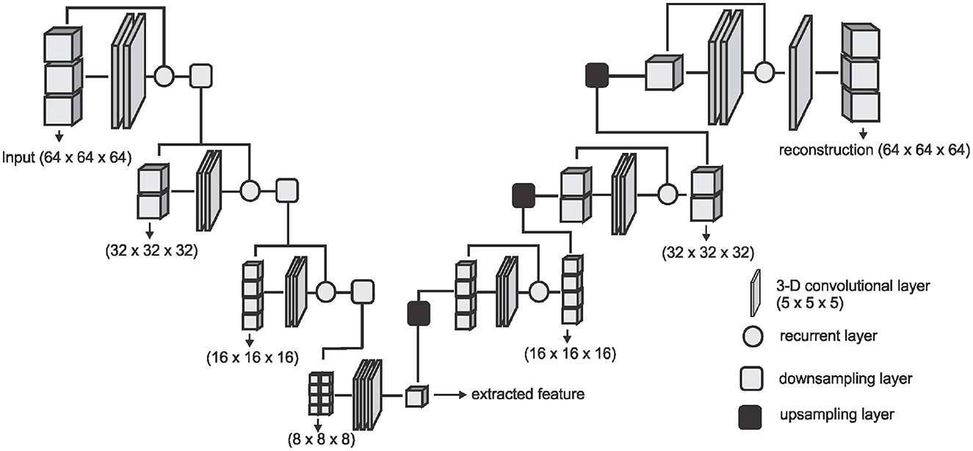
Architecture Of Algorithm:
This Photo by Unknown Author is licensed under CC BY
LOCAL BINARY PATTERN

Slide 14
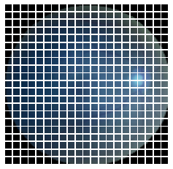
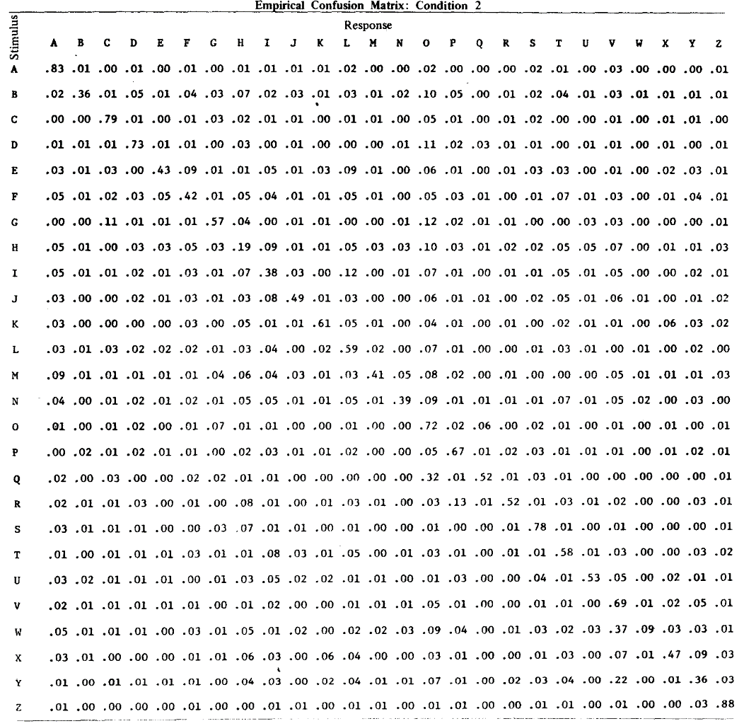
Transform Pixels Into Values:

Slide 15
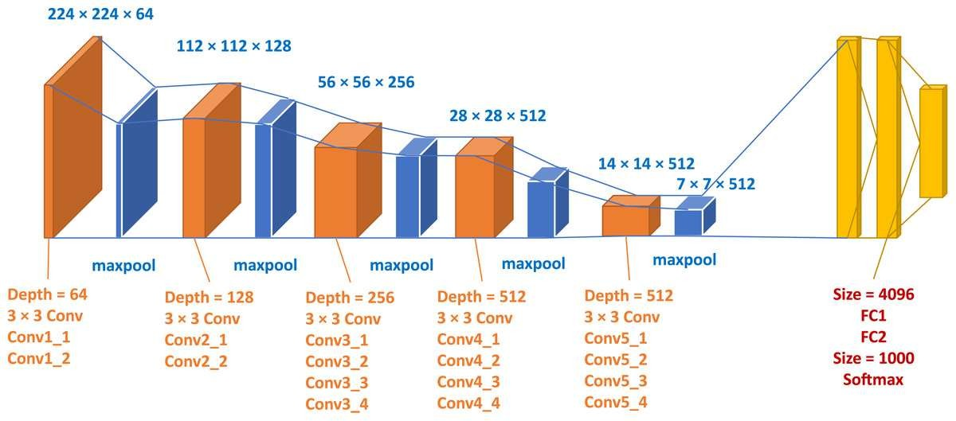
Existing Models - Architecture Of VGG 19

Slide 16
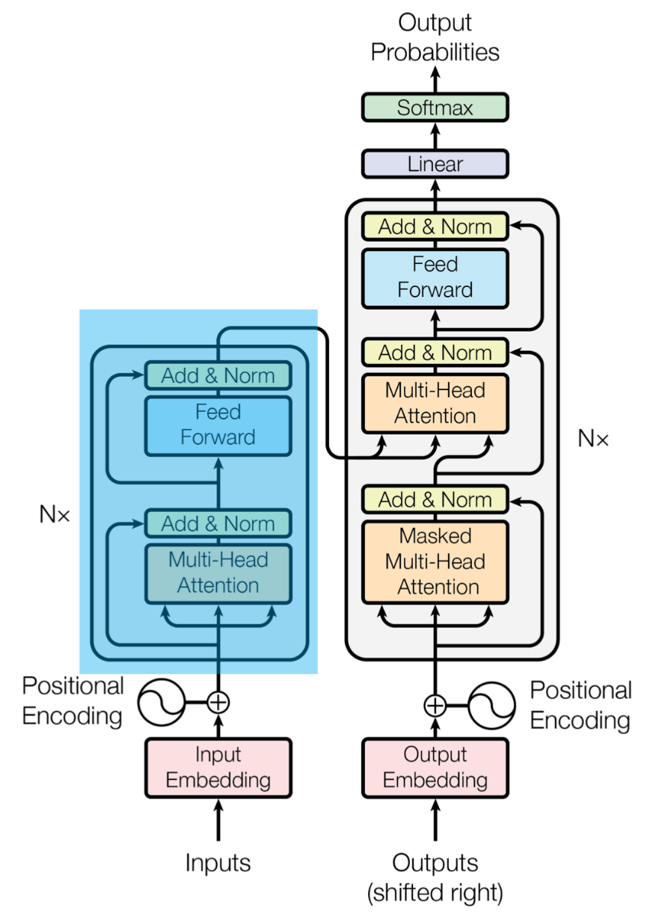
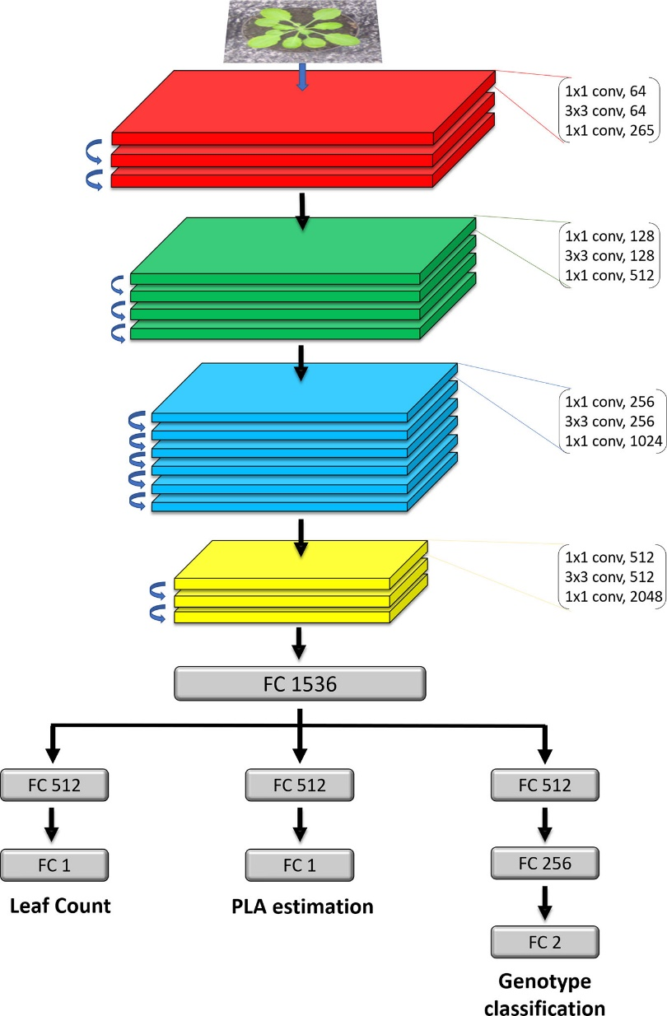
ResNet 50 Vision Transformer

Slide 17
Modules:
numpy (as np): Used for numerical computations and handling arrays.
pandas (as pd): Used for data manipulation and analysis, particularly for reading and working with CSV files.
cv2: OpenCV library for image processing tasks such as reading, resizing, and augmenting images.
Random: Used for generating random numbers and shuffling data.
VGG19, ResNet50: Pre-trained deep learning models available in Keras, used for transfer learning and building convolutional neural network architectures

Slide 18
THANK YOU

